Slide 1
struts

Slide 2
Introduction
The struts 2 framework is used to develop MVC-based web application.
The struts framework was initially created by Craig McClanahan and donated to Apache Foundation in May, 2000 and Struts 1.0 was released in June 2001.
The current stable release of Struts is Struts 2.3.16.1 in March 2, 2014.
This struts 2 tutorial covers all the topics of Struts 2 Framework with simplified examples for beginners and experienced persons.

Slide 3
The Struts 2 framework is used to develop MVC (Model View Controller) based web applications. Struts 2 is the combination of webwork framework of opensymphony and struts 1.
struts2 = webwork + struts1

Slide 4
The Struts 2 provides supports to POJO based actions, Validation Support, AJAX Support, Integration support to various frameworks such as Hibernate, Spring, Tiles etc, support to various result types such as Freemarker, Velocity, JSP etc

Slide 5
Struts 2 provides many features that were not in struts 1. The important features of struts 2 framework are as follows:
Configurable MVC components
POJO based actions
AJAX support
Integration support
Various Result Types
Various Tag support
Theme and Template support

Slide 6
Configurable MVC components
In struts 2 framework, we provide all the components (view components and action) information in struts.xml file. If we need to change any information, we can simply change it in the xml file.
POJO based actions
In struts 2, action class is POJO (Plain Old Java Object) i.e. a simple java class. Here, you are not forced to implement any interface or inherit any class.

Slide 7
AJAX support
Struts 2 provides support to ajax technology. It is used to make asynchronous request i.e. it doesn't block the user. It sends only required field data to the server side not all. So it makes the performance fast.
Integration Support
We can simply integrate the struts 2 application with hibernate, spring, tiles etc. frameworks.

Slide 8
Various Result Types
We can use JSP, freemarker, velocity etc. technologies as the result in struts 2.
Various Tag support
Struts 2 provides various types of tags such as UI tags, Data tags, control tags etc to ease the development of struts 2 application.
Theme and Template support
Struts 2 provides three types of theme support: xhtml, simple and css_xhtml. The xhtml is default theme of struts 2. Themes and templates can be used for common look and feel.

Slide 9
Model 1 and Model 2 (MVC) Architecture
Before developing the web applications, we need to have idea about design models. There are two types of programming models (design models)
Model 1 Architecture
Model 2 (MVC) Architecture

Slide 10
Model 1 Architecture
Servlet and JSP are the main technologies to develop the web applications.
Servlet was considered superior to CGI. Servlet technology doesn't create process, rather it creates thread to handle request. The advantage of creating thread over process is that it doesn't allocate separate memory area. Thus many subsequent requests can be easily handled by servlet.
Problem in Servlet technology Servlet needs to recompile if any designing code is modified. It doesn't provide separation of concern. Presentation and Business logic are mixed up.
JSP overcomes almost all the problems of Servlet. It provides better separation of concern, now presentation and business logic can be easily separated. You don't need to redeploy the application if JSP page is modified. JSP provides support to develop web application using JavaBean, custom tags and JSTL so that we can put the business logic separate from our JSP that will be easier to test and debug.

Slide 11
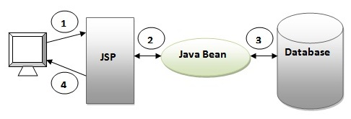
model1 architecture.

Slide 12
Description for model 1 architecture
Browser sends request for the JSP page
JSP accesses Java Bean and invokes business logic
Java Bean connects to the database and get/save data
Response is sent to the browser which is generated by JSP

Slide 13
Advantage of Model 1 Architecture
Easy and Quick to develop web application
Disadvantage of Model 1 Architecture
Navigation control is decentralized since every page contains the logic to determine the next page. If JSP page name is changed that is referred by other pages, we need to change it in all the pages that leads to the maintenance problem.
Time consuming You need to spend more time to develop custom tags in JSP. So that we don't need to use scriptlet tag.
Hard to extend It is better for small applications but not for large applications

Slide 14
Model 2 (MVC) Architecture
Model 2 is based on the MVC (Model View Controller) design pattern. The MVC design pattern consists of three modules model, view and controller.
Model The model represents the state (data) and business logic of the application.
View The view module is responsible to display data i.e. it represents the presentation.
Controller The controller module acts as an interface between view and model. It intercepts all the requests i.e. receives input and commands to Model / View to change accordingly.

Slide 15
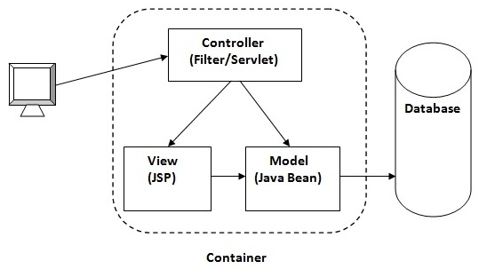
Model2 diagram

Slide 16
Advantage of Model 2 (MVC) Architecture
Navigation control is centralized Now only controller contains the logic to determine the next page.
Easy to maintain
Easy to extend
Easy to test
Better separation of concerns
Disadvantage of Model 2 (MVC) Architecture
We need to write the controller code self. If we change the controller code, we need to recompile the class and redeploy the application.

Slide 17
Solution of Model 2 Architecture: Configurable MVC Components
It uses the declarative approach for defining view components, request mapping etc. It resolves the problem of Model 2 architecture. The Struts framework provides the configurable MVC support. In struts 2, we define all the action classes and view components in struts.xml file.

Slide 18
Interceptors
Interceptor is an object that is invoked at the preprocessing and postprocessing of a request. In Struts 2, interceptor is used to perform operations such as validation, exception handling, internationalization, displaying intermediate result etc.

Slide 19
Advantage of interceptors
Pluggable If we need to remove any concern such as validation, exception handling, logging etc. from the application, we don't need to redeploy the application. We only need to remove the entry from the struts.xml file.

Slide 20
Struts 2 default interceptors
There are many interceptors provided by struts 2 framework. We have option to create our own interceptors. The struts 2 default interceptors(few) are as follows:
1) alias It converts similar parameters that have different names between requests.
2) debugging Provides several different debugging screens to the developer.
3) chain If it is used with chain result type, it makes the properties of previous action available in the current action.
4) checkbox It is used to handle the check boxes in the form. By this, we can detect the unchecked checkboxes.
5) cookie It adds a cookie to the current action.

Slide 21
Struts 2 ValueStack
A valueStack is simply a stack that contains application specific objects such as action objects and other model object.
At the execution time, action is placed on the top of the stack.
We can put objects in the valuestack, query it and delete it.
ValueStack Interface
The struts 2 framework provides an interface to deal with valuestack. It provides many useful methods

Slide 22
Methods of ValueStack interface
There are many methods in ValueStack interface. The commonly used methods are as follows:
public String findString(String expr) finds the string by evaluating the given expression.
public Object findValue(String expr) finds the value by evaluating the specified expression.
public Object findValue(String expr, Class c) finds the value by evaluating the specified expression.
public Object peek() It returns the object located on the top of the stack.
public Object pop() It returns the object located on the top of the stack and removes it.

Slide 23
public void push(Object o) It puts the object on the top of the stack.
public void set(String key, Object value) It sets the object on the stack with the given key. It can be get by calling the findValue(key) method.
public int size() It returns the number of objects from the stack

Slide 24
Struts 2 ActionContext
The ActionContext is a container of objects in which action is executed. The values stored in the ActionContext are unique per thread (i.e. ThreadLocal). So we don't need to make our action thread safe.
We can get the reference of ActionContext by calling the getContext() method of ActionContext class. It is a static factory method.
For example
ActionContext context = ActionContext.getContext();

Slide 25
Struts 2 ActionInvocation
The ActionInvocation represents the execution state of an action. It holds the action and interceptors objects.
ActionInvocation Interface
The struts framework provides ActionInvocation interface to deal with ActionInvocation. It provides many methods, some of them can be used to get the instance of ValueStack, ActionProxy, ActionContext, Result etc.

Slide 26
Methods of ActionInvocation Interface
o. | Method | Description
1) | public ActionContext getInvocationContext() | returns the ActionContext object associated with the ActionInvocation.
2) | public ActionProxy getProxy() | returns the ActionProxy instance holding this ActionInvocation.
3) | public ValueStack getStack() | returns the instance of ValueStack.
4) | public Action getAction() | returns the instance of Action associated with this ActionInvocation.
5) | public void invoke() | invokes the next resource in processing this ActionInvocation.
6) | public Result getResult() | returns the instance of Result.

Slide 27
Struts 2 OGNL
The Object Graph Navigation Language (OGNL) is an expression language. It simplifies the accessibility of data stored in the ActionContext.
The struts framework sets the ValueStack as the root object of OGNL. Notice that action object is pushed into the ValueStack. We can direct access the action property.

Slide 28
<s:property value="username"/>
Here, username is the property key.
The struts framework places other objects in ActionContext also e.g. map representing the request, session, application scopes.
To get these values i.e. not the action property, we need to use # notation. For example to get the data from session scope, we need to use #session as given in the following example:
<s:property name="#session['username']"/>

Slide 29
In this example, we are creating the struts 2 example without IDE. We can simply create the struts 2 application by following these simple steps:
Create the directory structure
Create input page (index.jsp)
Provide the entry of Controller in (web.xml) file
Create the action class (Product.java)
Map the request with the action in (struts.xml) file and define the view components
Create view components (welcome.jsp)
load the jar files
start server and deploy the project

Slide 30
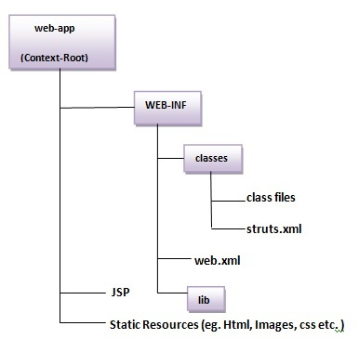

Slide 31
Create input page (index.jsp)
This jsp page creates a form using struts UI tags. To use the struts UI tags, you need to specify uri /struts-tags. Here, we have used s:form to create a form, s:textfield to create a text field, s:submit to create a submit button.

Slide 32
<%@ taglib uri="/struts-tags" prefix="s" %>
<s:form action="product">
<s:textfield name="id" label="Product Id"></s:textfield>
<s:textfield name="name" label="Product Name"></s:textfield>
<s:textfield name="price" label="Product Price"></s:textfield>
<s:submit value="save"></s:submit>
</s:form>

Slide 33
Provide the entry of Controller in (web.xml) file
In struts 2, StrutsPrepareAndExecuteFilter class works as the controller. As we know well, struts 2 uses filter for the controller. It is implicitly provided by the struts framework.

Slide 34
<?xml version="1.0" encoding="UTF-8"?>
<web-app>
<filter>
<filter-name>struts2</filter-name>
<filter-class>
org.apache.struts2.dispatcher.ng.filter.StrutsPrepareAndExecuteFilter
</filter-class>
</filter>
<filter-mapping>
<filter-name>struts2</filter-name>
<url-pattern>/*</url-pattern>
</filter-mapping>
</web-app>

Slide 35
Create the action class (Product.java)
This is simple bean class. In struts 2, action is POJO (Plain Old Java Object). It has one extra method execute i.e. invoked by struts framework by default.

Slide 36
package com.javatpoint;
public class Product {
private int id;
private String name;
private float price;
public int getId() {
return id; }
public void setId(int id) {
this.id = id; }
public String getName() {
return name; }
public void setName(String name) {
this.name = name;
}

Slide 37
public float getPrice() {
return price;
}
public void setPrice(float price) {
this.price = price;
}
public String execute(){
return "success";
}
}

Slide 38
Map the request in (struts.xml) file and define the view components
It is the important file from where struts framework gets information about the action and decides which result to be invoked. Here, we have used many elements such as struts, package, action and result.
struts element is the root elements of this file. It represents an application.
package element is the sub element of struts. It represents a module of the application. It generally extends the struts-default package where many interceptors and result types are defined.

Slide 39
action element is the sub element of package. It represents an action to be invoked for the incoming request. It has name, class and method attributes. If you don't specify name attribute by default execute() method will be invoked for the specified action class.

Slide 40
result element is the sub element of action. It represents an view (result) that will be invoked. Struts framework checks the string returned by the action class, if it returns success, result page for the action is invoked whose name is success or has no name. It has name and type attributes. Both are optional. If you don't specify the result name, by default success is assumed as the result name. If you don't specify the type attribute, by default dispatcher is considered as the default result type. We will learn about result types later.

Slide 41
<?xml version="1.0" encoding="UTF-8" ?>
<!DOCTYPE struts PUBLIC "-//Apache Software Foundation//DTD Struts
Configuration 2.1//EN" "http://struts.apache.org/dtds/struts-2.1.dtd">
<struts>
<package name="default" extends="struts-default">
<action name="product" class="com.javatpoint.Product">
<result name="success">welcome.jsp</result>
</action>
</package>
</struts>

Slide 42
Create view components (welcome.jsp)
It is the view component the displays information of the action. Here, we are using struts tags to get the information.
The s:property tag returns the value for the given name, stored in the action object.

Slide 43
<%@ taglib uri="/struts-tags" prefix="s" %>
Product Id:<s:property value="id"/><br/>
Product Name:<s:property value="name"/><br/>
Product Price:<s:property value="price"/><br/>

Slide 44
Load the jar files
To run this application, you need to have the struts 2 jar files. Here, we are providing all the necessary jar files for struts 2. Download it and put these jar files in the lib folder of your project.
download the struts2 jar files

Slide 45
start server and deploy the project
Finally, start the server and deploy the project and access it.

Slide 46
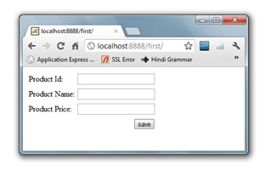

Slide 47
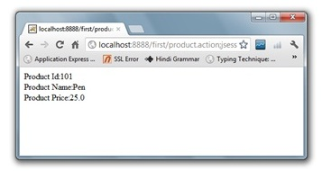

Slide 48
What’s a framework?
A framework is a piece of structural software. We say structural because structure is perhaps a larger goal of the framework than any specific functional requirement.
A framework tries to make generalizations about the common tasks and workflow of a specific domain. The framework then attempts to provide a platform upon which
applications of that domain can be more quickly built.
The framework does this primarily in two ways. First, the framework tries to automate all the tedious tasks of the
domain.
Second, the framework tries to introduce an elegant architectural solution to the common workflow of the domain in question.

Slide 49
A web application framework is a piece of structural software that provides automation of common tasks of the domain as well as a built-in architectural solution that can be easily inherited by applications implemented on the framework.

Slide 50
A FRAMEWORK AUTOMATES COMMON TASKS
Don’t reinvent the wheel. Any good framework will provide mechanisms for convenient and perhaps automatic solutions to the common tasks of the domain, saving developers the effort of reinventing the wheel.
Reflecting back on our discussion of the common tasks of the web application domain, we can then infer that a web application framework will provide some sort of built-in mechanisms for tasks such as converting data from HTTP string representation to Java data types, data validation,separation of business and data layer calls from web-related work, internationalization,and presentation rendering.
Good frameworks provide elegant, if not transparent, mechanisms for relieving the developer of these mundane tasks.

Slide 51
A FRAMEWORK PROVIDES AN ARCHITECTURAL SOLUTION
While everyone can appreciate automation of tedious tasks, the structural features of frameworks are perhaps more important in the big scheme of things. The framework’s structure comes from the workflow abstractions made by the classes and interfaces
of the framework itself.
Being an action-oriented framework, one of the key abstractions at the heart of the Struts 2 architecture is the action. We’ll see the others in a few pages. When you build an application on a framework, you are buying intothat framework’s architecture.
Sometimes you can fight against the architectural imperative of the framework, but a framework should offer its architecture in a waythat makes it hard to refuse. If the architecture of the framework is good, why not let your application gracefully inherit that architecture?

Slide 52
Struts 2 takes advantage of the many lessons learned to present a cleaner implementation of MVC. At the same time, it introduces several new architectural features that make the framework cleaner and more flexible.
These new features include interceptors for layering cross-cutting concerns away from action logic; annotation-based configuration to reduce or eliminate XML configuration; a powerful expression language, Object-Graph Navigation Language(OGNL), that transverses the entire framework; and a mini-MVC–based tag API that supports modifiable and reusable UI components.

Slide 53
Building the view:tags and results
Before we talk about the details of how Struts 2 tags can help you dynamically pipe data into the rendering of your pages, let’s talk about where that data comes from. While we focused on the data moving into the framework in the previous chapter, we’ll now focus on the data leaving the framework.
When a request hits the framework, one of the first things Struts 2 does is create the objects that’ll store all the important data for the request. If we’re talking about your application’s domain-specific data, which is the data that you’ll most frequently access with your tags, it’ll be stored in the ValueStack.
But processing a request requires more than just your application’s domain data. Other, more infrastructural, data must be stored also. All of this data, along with the ValueStack itself, is stored in something called the ActionContext.

Slide 54
The ActionContext helps clean things up by providing the notion of a context for the execution of an action.
By context we mean a simple container for all the important data and resources that surround the execution of a given action.
A good example of the type of data we’re talking about is the map of parameters from the request, or a map of session attributes from the Servlet Container.

Slide 55
SELECTING THE ROOT OBJECT FOR OGNL
OGNL expression must choose one of the objects in the ActionContext to use as its root object.
By default, the ValueStack will serve as the root object for resolving all OGNL expressions that don’t explicitly name an initial object.
OGNL expressions can start with a special syntax that names the object from the context against which they should resolve. The following OGNL expression demonstrates this syntax: #session['user']

Slide 56
This OGNL expression actively names the session map from the ActionContext via the # operator of the expression language.
The # operator tells OGNL to use the named object, located in its context, as the initial object for resolving the rest of the expression.

Slide 57
The ValueStack: a virtual object
When Struts 2 receives a request, it immediately creates an ActionContext, a ValueStack,and an action object.
As a carrier of application data, the action object is quickly placed on the ValueStack so that its properties will be accessible, via OGNL, to the far reaches of the framework.

Slide 58
An overview of Struts tags
The Struts 2 tag API provides the functionality to dynamically create robust web pages by leveraging conditional rendering and integration of data from your application’s domain model found on the ValueStack.
Struts 2 comes with many different types of tags. For organizational purposes, they can be broken into four categories: data tags, control-flow tags, UI tags, and miscellaneous tags.

Slide 59
Data tags focus on ways to extract data from the ValueStack and/or set values in the ValueStack.
Control-flow tags give you the tools to conditionally alter the flow of the rendering process; they can even test values on the ValueStack.
The miscellaneous tags are a set of tags that don’t quite fit into the other categories. These leftover tags include such useful functionality as managing URL rendering and internationalization of text.

Slide 60
Once you identify a tag that you want to use, you simply move on to your view technology of choice—JSP, Velocity, or FreeMarker.

Slide 61
JSP SYNTAX
The JSP versions of the Struts 2 tags are just like any other JSP tags. The following property tag demonstrates the simple syntax:
<s:property value="name"/>
The only other thing to note is that you must have the property taglib declaration at the top of your page before using the Struts 2 tags. This is standard JSP stuff, and the following snippet from one of our Struts 2 Portfolio application’s JSPs should show you what you need:

Slide 62
<%@ page contentType="text/html; charset=UTF-8" %>
<%@ taglib prefix="s" uri="/struts-tags" %>

Slide 63
VELOCITY SYNTAX You can also use Velocity templates for your view technology. All you need to do is specify your result type to the built-in velocity result type.
Here’s the Velocity version of the property tag:
#sproperty( "value=name" )

Slide 64
JSP form tag from the Struts 2 Portfolio application that uses a closing tag
<s:form action="Register">
<s:textfield name="username" label="Username"/>
<s:password name="password" label="Password"/>
<s:textfield name="portfolioName" label="Enter a name"/>
<s:submit value="Submit"/>
</s:form>

Slide 65
And here’s the same tag as a Velocity macro
#sform ("action=Register")
#stextfield ("label=Username" "name=username")
#spassword ( "label=Password" "name=password")
#stextfield ( "label=Enter a name" "name=portfolioName")
#ssubmit ("value=Submit")
#end

Slide 66
FREEMARKER SYNTAX
The framework also provides out-of-the-box support for using FreeMarker templates as the view-layer technology.
<@s.property value="name"/>

Slide 67
The validation framework architecture
There are three main components at play in the validation framework: the domain data, validation metadata, and the validators. Each plays a vital role in the work of validation.
Domain Data
Example: username, password, and age.

Slide 68
VALIDATION METADATA
a middle component lies between the validators and the data properties themselves.
This middle component is the metadata that associates individual data properties with the validators that should be used to verify the correctness of the values in those properties at runtime.
You can associate as many validators with each property as you like, including zero if that makes sense for your requirements.

Slide 69
When it comes to the details of implementation, the metadata layer offers a choice.
The developer can map data properties to validators with XML files or with Java annotations

Slide 70
VALIDATORS
The actual work in all of this is done by the validators themselves.
A validator is a reusable component that contains the logic for performing some fine-grained act of validation.

Slide 71
For instance, our username property is mapped to the required stringvalidator.
This validator verifies that the value of the username property, or whatever property it validates, is a nonempty String value. The password property is mapped torequiredstring and stringlength.
The stringlength validator checks that the stringis of a desired length

Slide 72
Custom validator
We can define our own validation logic (custom validation) in struts 2 by implementing the Validateable interface in the action class.
The workflow interceptor is used to get information about the error messages defined in the action class.

Slide 73
Workflow Interceptor
The workflow interceptor checks if there is any validation errors or not. It doesn't perform any validation.
It is applied when action class implements the Validateable interface. The input is the default parameter for this interceptor that determines the result to be invoked for the action or field error.
It is found in the defaultStack so we don't need to define it explicitly.

Slide 74
Parameter | Description
inputResultName | specifies the result name to be returned if field error or action error is found. It is set to input bydefault.

Slide 75
Validateabale interface
The Validateable interface must be implemented to perform validation logic in the action class. It contains only one method validate() that must be overridden in the action class to define the validation logic. Signature of the validate method is:
public void validate();

Slide 76
ValidationAware interface
The ValidationAware interface can accept the field level or action class level error messages. The field level messages are kept in Map and Action class level messages are kept in collection. It should be implemented by the action class to add any error message.
Methods of ValidatationAware interface
The methods of ValidationAware interface are as follows:

Slide 77
Method | Description
void addFieldError(String fieldName,String errorMessage) | adds the error message for the specified field.
void addActionError(String errorMessage) | adds an Action-level error message for this action.
void addActionMessage(String message) | adds an Action-level message for this action.
void setFieldErrors(Map<String,List<String>> map) | sets a collection of error messages for fields.
void setActionErrors(Collection<String> errorMessages) | sets a collection of error messages for this action.
void setActionMessages(Collection<String> messages) | sets a collection of messages for this action.
boolean hasErrors() | checks if there are any field or action errors.
boolean hasFieldErrors() | checks if there are any field errors.
boolean hasActionErrors() | checks if there are any Action-level error messages.
boolean hasActionMessages() | checks if there are any Action-level messages.
Map<String,List<String>> getFieldErrors() | returns all the field level error messages.
Collection<String> getActionErrors() | returns all the Action-level error messages.
Collection<String> getActionMessages() | returns all the Action-level messages.

Slide 78
Steps to perform custom validation
The steps are as follows:
create the form to get input from the user
Define the validation logic in action class by extending the ActionSupport class and overriding the validate method
Define result for the error message by the name input in struts.xml file

Slide 79
Example to perform custom validation
In this example, we are creating 4 pages :
index.jsp for input from the user.
RegisterAction.java for defining the validation logic.
struts.xml for defining the result and action.
welcome.jsp for the view component.

Slide 80
Create index.jsp for input
This jsp page creates a form using struts UI tags. It receives name, password and email id from the user.
index.jsp
<%@ taglib uri="/struts-tags" prefix="s" %>
<s:form action="register">
<s:textfield name="name" label="Name"></s:textfield>
<s:password name="password" label="Password"></s:password>
<s:submit value="register"></s:submit>
</s:form>

Slide 81
Create the action class
This action class inherits the ActionSupport class and overrides the validate method to define the validation logic.
RegisterAction.java
package com.javatpoint;
import com.opensymphony.xwork2.ActionSupport;
public class RegisterAction extends ActionSupport{
private String name,password;
public void validate() {
if(name.length()<1)
addFieldError("name","Name can't be blank");
if(password.length()<6)
addFieldError("password","Password must be greater than 5");
}
//getters and setters
public String execute(){
//perform business logic here
return "success";
}
}

Slide 82
Define a input result in struts.xml
This xml file defines an extra result by the name input, that will be invoked if any error message is found in the action class.
struts.xml
<?xml version="1.0" encoding="UTF-8" ?>
<!DOCTYPE struts PUBLIC "-//Apache Software Foundation//DTD Struts
Configuration 2.1//EN" "http://struts.apache.org/dtds/struts-2.1.dtd">
<struts>
<package name="default" extends="struts-default">
<action name="register" class="com.javatpoint.RegisterAction">
<result>welcome.jsp</result>
<result name="input">index.jsp</result>
</action>
</package>
</struts>

Slide 83
Create view component
It is the simple jsp file displaying the information of the user.
welcome.jsp
<%@ taglib uri="/struts-tags" prefix="s" %>
Name:<s:property value="name"/><br/>
Password:<s:property value="password"/><br/>

Slide 84
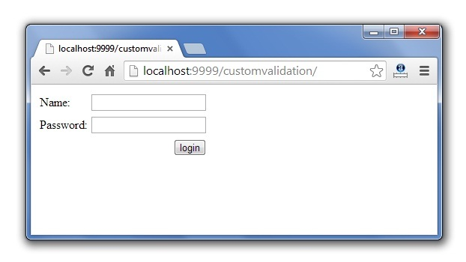
Output of custom validator

Slide 85
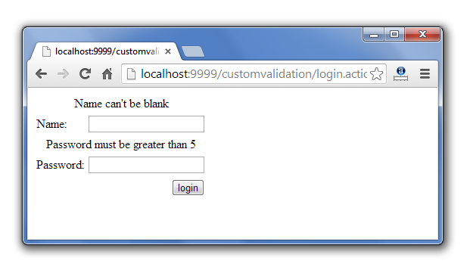

Slide 86
The regex validator validates the given string with the specified regular expression. It can be used in password, security key etc.
Parameters of regex validator
There is 4 parameters defined for regex validator.

Slide 87
Parameter | Description
fieldName | specifies the field name that is to be validated. It is required in Plain-Validator only.
expression | specifies the regular expression.
caseSensitive | specifies if the expression should be matched in case sensitive way. It is true bydefault.
trim | specifies if the value should be trimmed before matching. It is true bydefault.

Slide 88
Example of regex validator
<validators>
<!-- Plain Validator Syntax -->
<validator type="regex">
<param name="fieldName">data</param>
<param name="expression">[A-Z,a-z,0-9]{5}</param>
<message>data must be alpha numeric of 5 digits</message>
</validator>
</validators>

Slide 89
<validators>
<!-- Field Validator Syntax -->
<field name="data">
<field-validator type="regex">
<param name="expression">[A-Z,a-z,0-9]{5}</param>
<message>data must be alpha numeric of 5 digits</message>
</field-validator>
</field>
</validators>

Slide 90
Struts 2 Architecture and Flow
The architecture and flow of struts 2 application, is combined with many components such as Controller, ActionProxy, ActionMapper, Configuration Manager, ActionInvocation, Inerceptor, Action, Result etc.
Here, we are going to understand the struts flow by 2 ways:
struts 2 basic flow
struts 2 standard architecture and flow provided by apache strutsStruts 2 basic flow
Let's try to understand the basic flow of struts 2 application by the given figure:

Slide 91
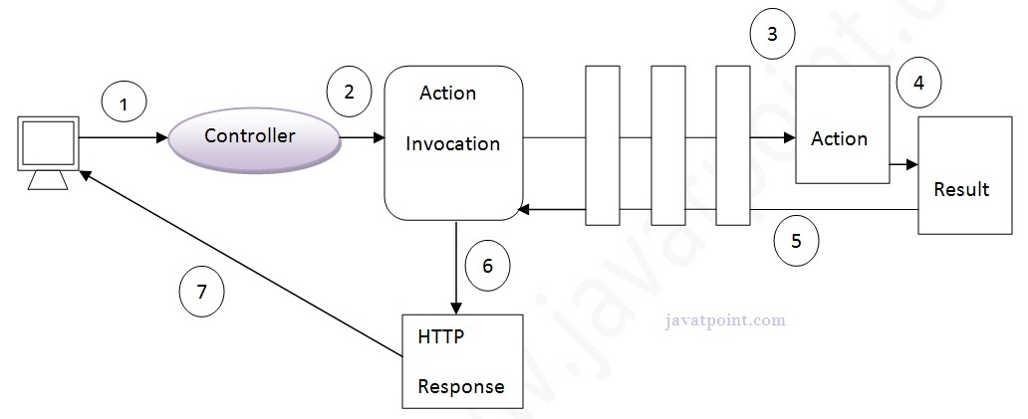

Slide 92
User sends a request for the action
Controller invokes the ActionInvocation
ActionInvocation invokes each interceptors and action
A result is generated
The result is sent back to the ActionInvocation
A HttpServletResponse is generated
Response is sent to the user

Slide 93
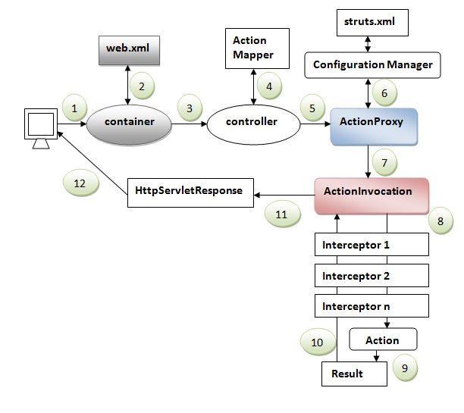
Struts 2 standard flow (Struts 2 architecture)
Let's try to understand the standard architecture of struts 2 application by this simple figure:

Slide 94
User sends a request for the action
Container maps the request in the web.xml file and gets the class name of controller.
Container invokes the controller (StrutsPrepareAndExecuteFilter or FilterDispatcher). Since struts2.1, it is StrutsPrepareAndExecuteFilter. Before 2.1 it was FilterDispatcher.
Controller gets the information for the action from the ActionMapper
Controller invokes the ActionProxy
ActionProxy gets the information of action and interceptor stack from the configuration manager which gets the information from the struts.xml file.
ActionProxy forwards the request to the ActionInvocation
ActionInvocation invokes each interceptors and action
A result is generated
The result is sent back to the ActionInvocation
A HttpServletResponse is generated
Response is sent to the user

Slide 95
What OGNL does
OGNL is a powerful technology that’s been integrated into the Struts 2 framework to help with data transfer and type conversion. OGNL is the glue between the framework’sstring-based HTTP input and output and the Java-based internal processing.
It’s quite powerful and, while it seems that you can use the framework without really knowing about OGNL, your development efforts will be made many times more efficientby spending a few moments with this oddly named power utility.

Slide 96
TYPE CONVERTERS
In addition to the expression language, we’ve also been using OGNL type converters.
Even in this simple case of the Struts 2 property tag, a conversion must be made from the Java type of the property referenced by the OGNL expression language to the string format of the HTML output.

